Slide 1
P609
World Development Measurements
- Yogita K Borole
- Sakshi Khot
- Sachin Astrong
- Vaishnavi Charate
- Jithendra Kottu
- DURGA SRUJAN VEERLA
December 2025

Slide 2
Agenda
Project Overview
Dataset Overview
Methodology
Economical Survey
Health Survey
Population Survey
Deployment

Slide 3
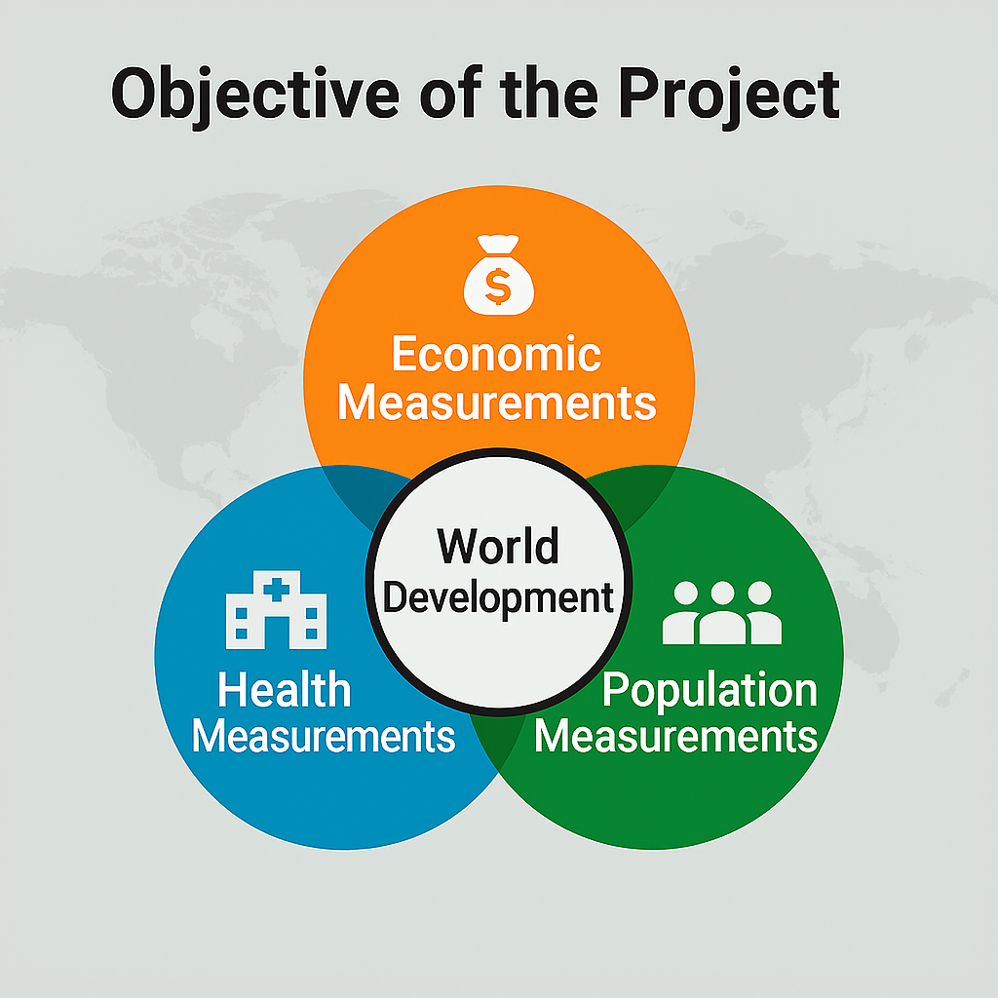

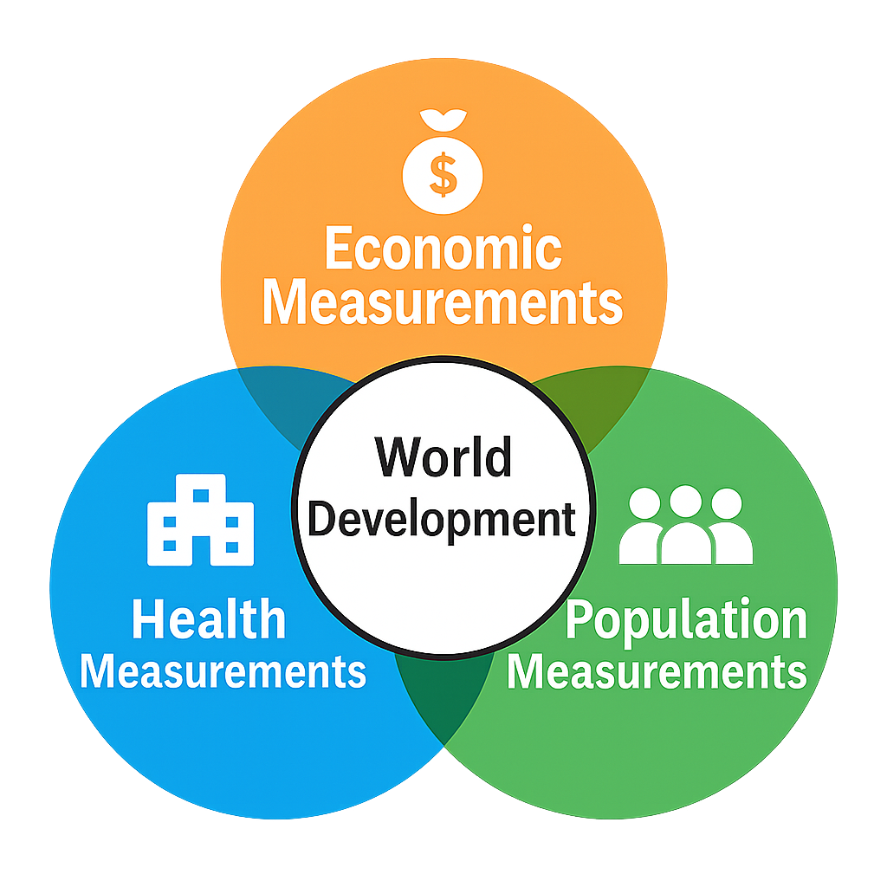
Objective
World development measurements aim to monitor and enhance countries' progress toward inclusive, equitable growth.
The world development is a multidimensional concept.

Slide 4
Dataset Overview
The world developement indicators (e.g. GDP, life expectancy, population details)
Number of countries: 208
Number of features: 25
Preprocessing steps:
Remove special characters
Handling outliers
Handling missing values
Label Encoding
Standardization
Dimensinality Reduction
Regularization

Slide 5
Methodology
Clustering Algorithm(s):
KMeans
DBSCAN
Agglomerative
Gaussian Mixture Model
Spectral
MeanShift
Evaluation Metrics:
Silhouette Score
Davies–Bouldin index
Tracking tool:
MLFlow

Slide 6
Economic Survey
Reflect a country’s financial health and productivity.
Common indicators:
Business Tax Rate
Ease of Business
GDP
Ease of Business
Population 15-64
P.T.O.

Slide 7
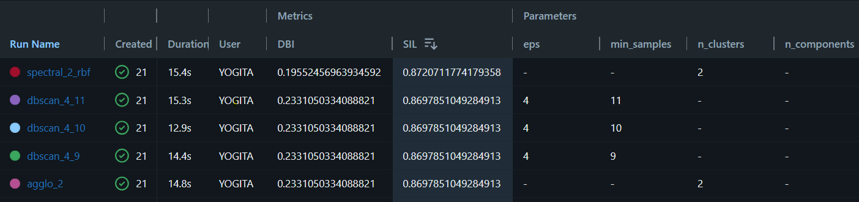
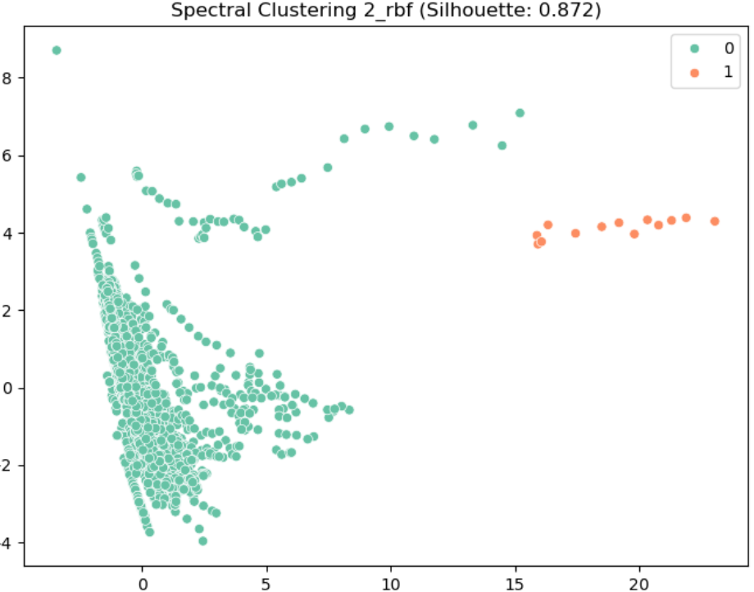
Evaluation of Economical survey
Finalised model
Spectral
(n_clusters:2; affinity:rbf)

Slide 8
Health Survey
Capture the well-being and longevity of populations.
Common indicators:
Birth Rate
Health Exp % GDP
Health Exp/Capita
Life Expectancy
Population
P.T.O.

Slide 9
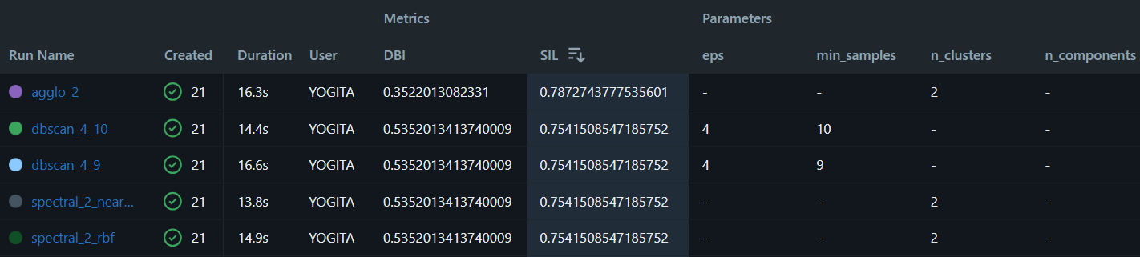
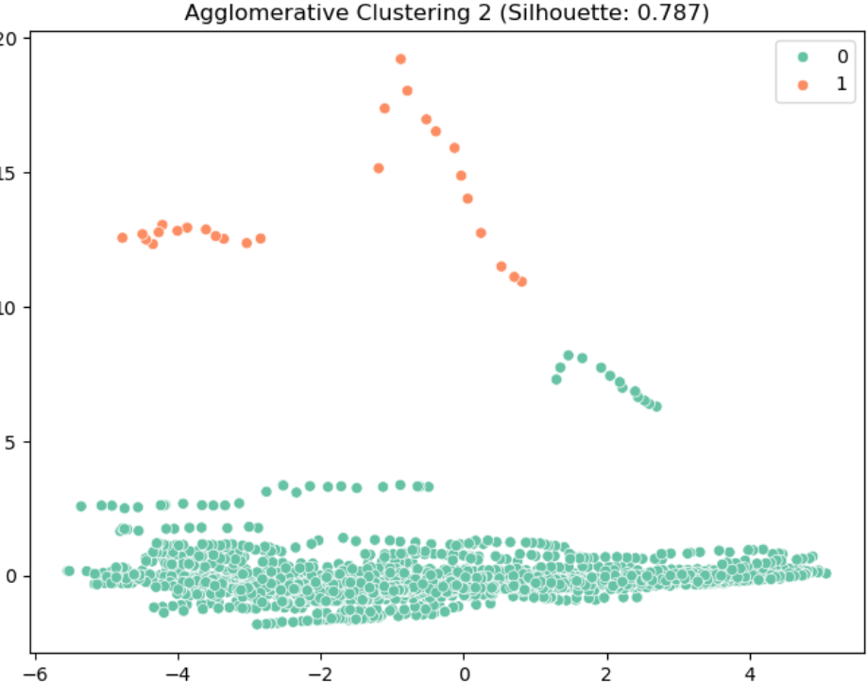
Evaluation of Health survey
Finalised model
Agglomerative
(n_clusters:2)

Slide 10
Population Survey
Describe demographic structure and growth dynamics.
Common indicators:
Birth Rate
Life Expectancy
Population Agewise
Population Total
Population Urban
Tourism Inbound/Outbound
P.T.O.

Slide 11
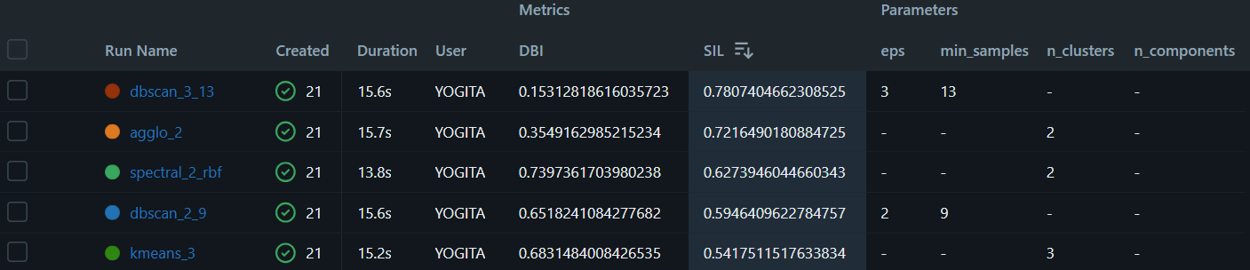
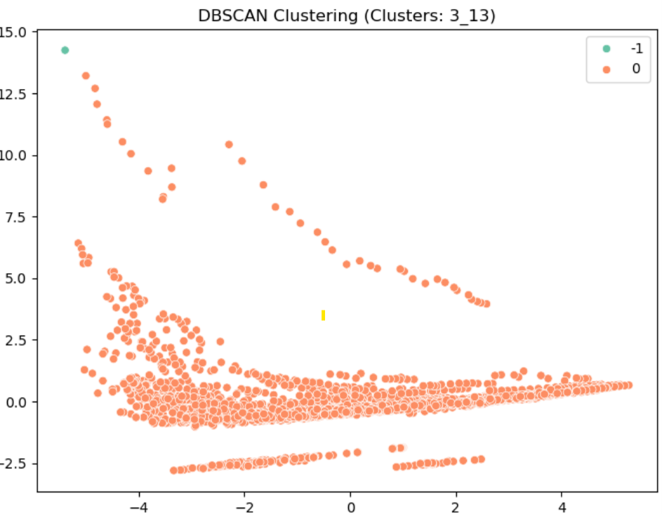
Evaluation of Population survey
Finalised model
DBSCAN
(eps:3; min_smaples:13)

Slide 12
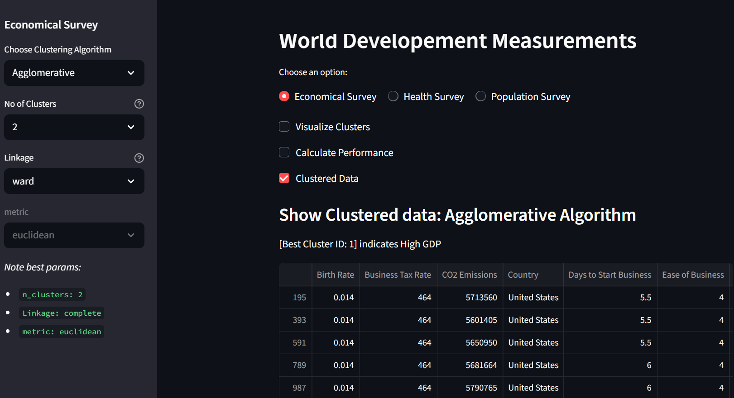
Deployment

Slide 13
Any Ques?

Slide 14
Thank you.

